Slide 1
WOSMIP-8 Overview
TW Bowyer

Slide 2
The views expressed in this presentation do not necessarily reflect those of the United States, the US Department of Energy, or the Pacific Northwest National Laboratory

Slide 3
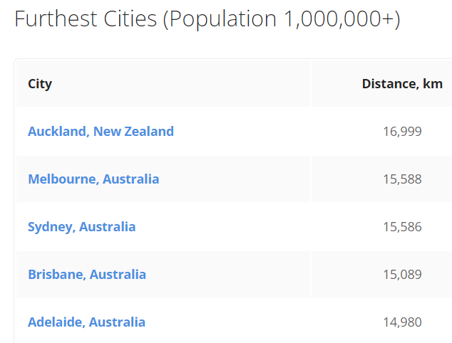
Thank you!
Fun Fact. These are the major cities the furthest from Stockholm.
A special thank you to
FOI
Scienta
ISTI
The CTBTO Preparatory Commission (PrepCom)
The US Department of Energy

Slide 4
Welcome back
WOSMIP Remote and WOSMIP Remote 2 were great, but all remote workshops lack needed spontaneous and informal discussions, creative idea generation and frank opinions are difficult to voice
WOSMIP-8 is our first in-person opportunity in quite a while for science-based discussions, trading of ideas, and presentation of results of work done over the last few years
Introducing the new WOSTER best poster award
Please take time to vote for the best poster noting
Best = Best R&D, activity, or development that furthers the mitigation, signatures, or understanding of isotope production in the environment
Each person gets three votes and the poster with the highest tally wins the coveted WOSTER Medal

Slide 5
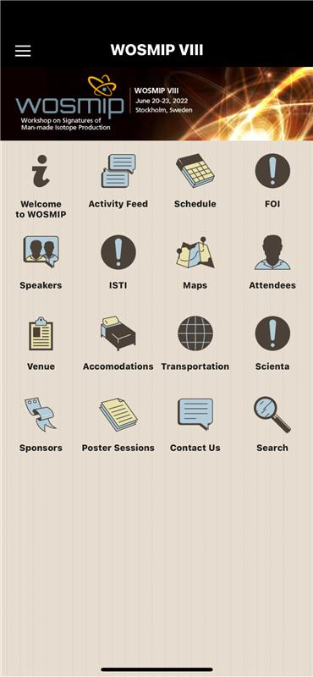
References
See www.wosmip.org (new context and links to presentations)
Also, if you haven’t downloaded it, try the WOSMIP App (see our conference coordinators if you haven’t been given a password, or need assistance)
Agenda, maps, chat function, etc.

Slide 6
Relevant current events
STAX and other stack monitoring underway
The IMS operation of RN stations
ATM challenges and XeBET (background estimator tool)
On-going regional measurements in the Ro5
Background measurements in Japan and the UK

Slide 7
The WOSMIP Workshop
WOSMIP was designed with the following in mind:
Allow for open discussion of issues among the participants on issues affecting the airborne concentration of isotopes in the environment
Encourage engagement between two distinct communities whose work overlaps
Discuss creative solutions to mitigate the effect of emissions on nuclear explosion monitoring
Allow for collaborative engagement with peers on issues of importance to them

Slide 8
WOSMIP-8 at a glance
Monday
Introductions
Background measurements
ROUNDTABLE DISCUSSION
Poster session 1 and reception at 6PM
Tuesday
Stack monitoring and measurement equipment
ROUNDTABLE DISCUSSIONS
Conference dinner at 6PM
Wednesday
Tour of Scienta Sensor Systems in Uppsala (buses)
Poster session 2 and reception immediately after return ~4PM
Thursday
Atmospheric transport modeling
ROUNDTABLE DISCUSSION
The WOSTER best poster award (Based on your voting!)
WOZZIE

Slide 9
The Big Picture
Policy discussions in Vienna have been useful to understand a number of views on the subject of emissions from isotope production
The impact of emissions from man-made sources on nuclear explosion monitoring continues to dominate the worries of policy makers in the PrepCom in Vienna
The International Monitoring System sees the effects of emissions from isotope production essentially “every day”

Slide 10
WOSMIP-8 focus areas
Atmospheric Transport Modeling
Stack Monitoring
Status of the IMS
Sources of Detected Radioactivity

Slide 11
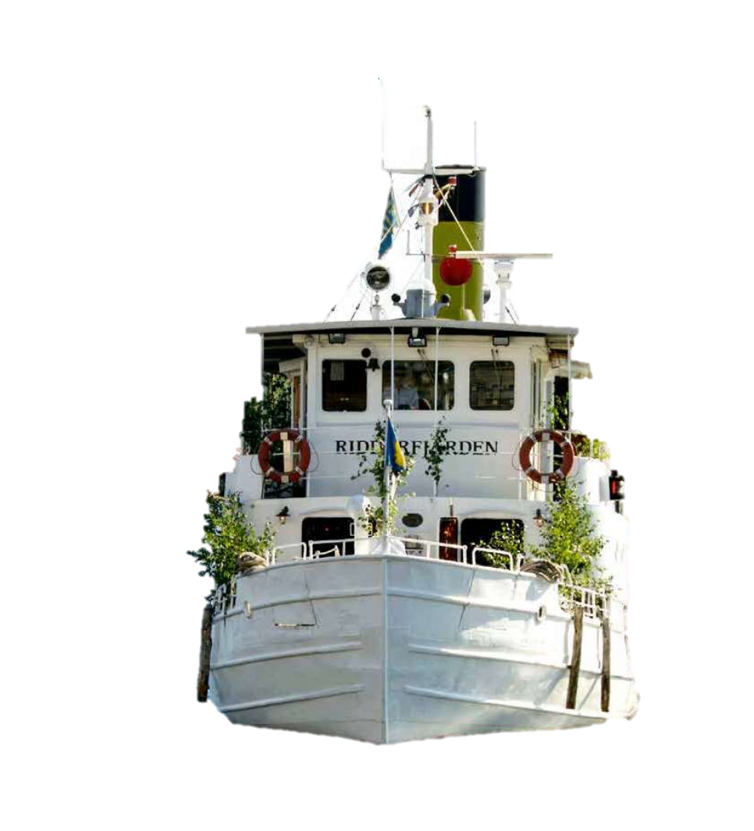
Conference Dinner
I’m on a boat!
Tuesday night
Hosted by FOI and CTBTO Prepcom
The Riddarjäden
All registered WOSMIP participants are welcome
Please confirm attendance with our conference staff so that the spot might be used for someone else

Slide 12
Poster sessions
Monday
Poster session 1
With a reception hosted by PNNL
Wednesday
Poster session 2
With a reception hosted by ISTI

Slide 13
Tour of Scienta Sensor Systems
Wednesday
Lunch will be served
A demonstration of the STAX software will be given by ISTI
Please see your agenda for times
We will board buses and return at approximately 3PM
Following the tour there will be a reception and Poster session 2 hosted by ISTI

Slide 14
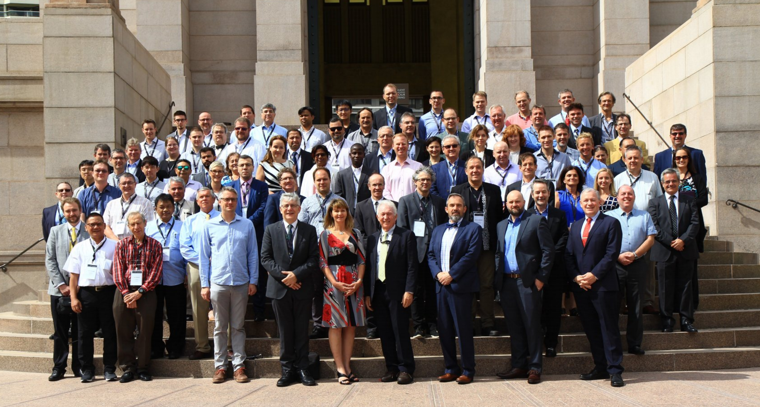
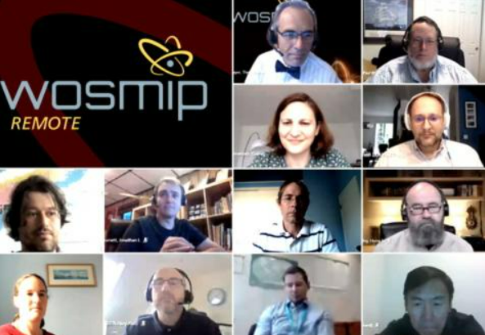
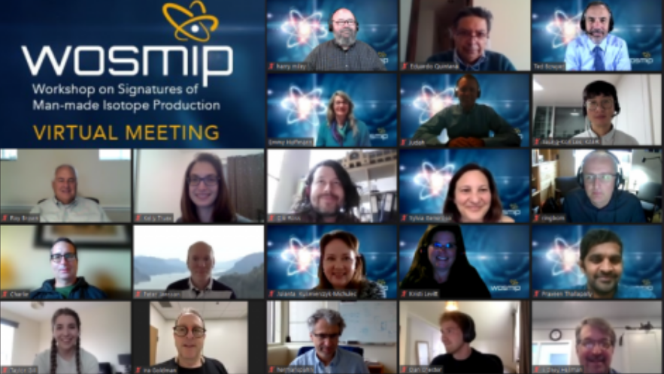
WOSMIP-7 WOSMIP Remote WOSMIP Remote 2

Slide 15
Some thoughts from Takeaways from last WOSMIP
We didn’t have enough time to talk (and the global pandemic) hasn’t helped
We have tried to address that with four roundtable discussions
The poster sessions will be great! Approximately 40 posters

Slide 16
WOSMIP - 8 Sponsors

Slide 17
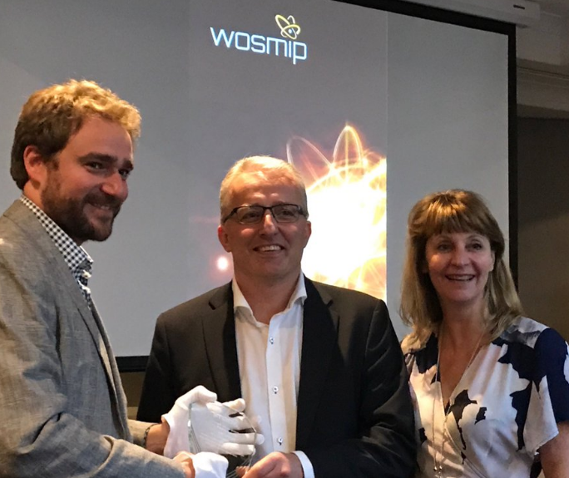
The WOZZIE
WOZZIE-7 was awarded to Anders Ringbom for his pioneering and exquisite work in sensitive xenon monitoring
WOZZIE-8 will be presented on Thursday afternoon!

Slide 18
Where is the next WOSMIP?
We rely on our friends and partners to host these workshopsWe have not yet made any plans along this line, however, we do want to hear your ideas
If your organization is interested in hosting, please contact the organizers

Slide 19
In Summary
We hope to have spirited discussions
Remember – the social events are meant to allow for discussions on any topics you feel worth the time
We thank our sponsors for making agreeing to fund this workshop possible and we look forward to interesting discussions

