Slide 1

Project Update

Slide 2


History of STAX
STAX was developed through discussions at WOSMIP
  Stack data with ATM can improve nuclear explosion monitoring
  HPGe stack detection systems could provide useful info for production facilities
  STAX project guidelines came from NDC discussions

Slide 3

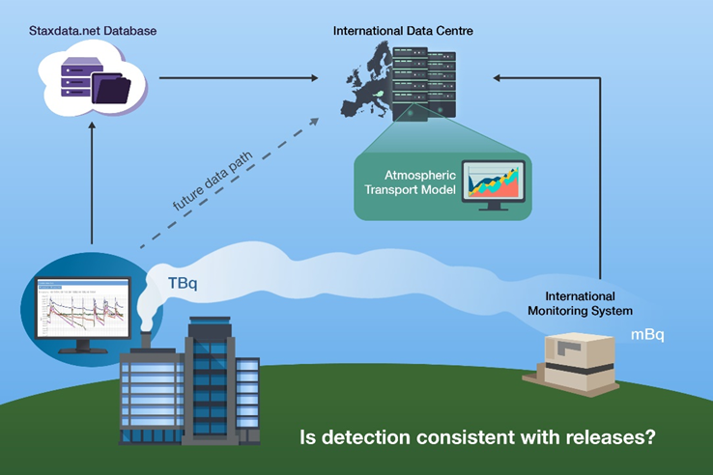
The STAX project is…
Establishing voluntary partnerships with facilities
Purchasing and installing slightly modified commercially available stack monitoring systems in facilities
Maintaining and optimizing system performance
Developing data sharing agreements with facilities and NDCs to control access to data
Developing tools to view, access, and use the data

Slide 4
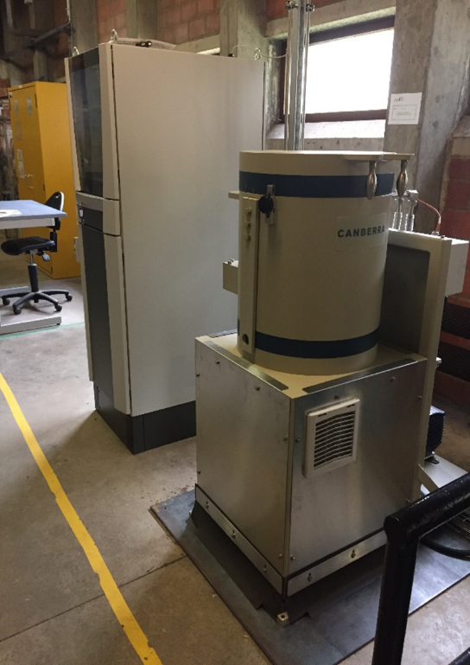
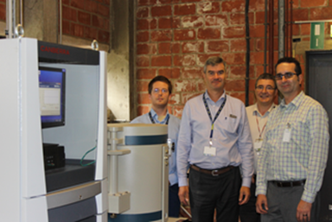
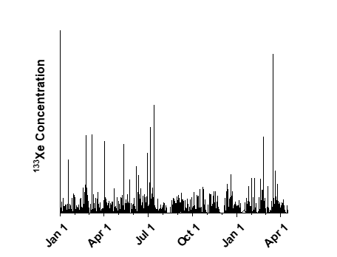
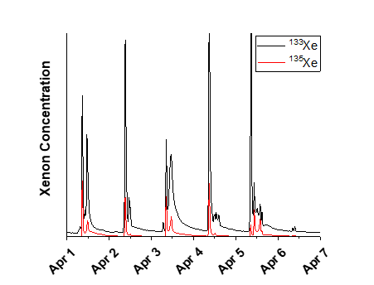




Update in Belgium
A Mirion built system was installed in IRE in December 2017
Radioxenon emission data collected every 15 min is automatically transmitted to www.staxdata.net via encryption
Some equipment maintenance has been required
Data sharing ongoing with NDCs
  Belgium, Canada, France, Germany, U.S., UK, Palau
Recent and upcoming publications in the Journal of Environmental Radioactivity
  Analysis of Environmental Radioxenon Detections in the UK, M. A. Goodwin, A. V. Davies, R. Britton, AWE, UK
  Use of STAX data in global-scale simulation of ¹³³Xe atmospheric background, S. Generoso, P. Achim, M. Morin, P. Gross and G. Douysset, CEA, France
  Trends, events and potential sources of Xe-detections in the German radioxenon network A. Bollhöfer, S. Brander, R. Krais, S. Schmid, O. Ross, C. Schlosser, BfS, Germany
High-purity germanium (HPGe) detector installed in IRE
Left: 133Xe concentration for 2019. Right: 133Xe and 135Xe concentration for April 1-7

Slide 5
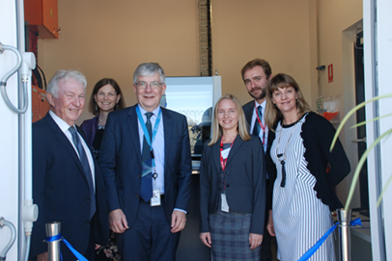
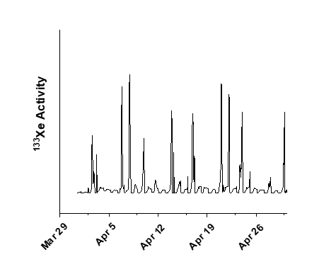
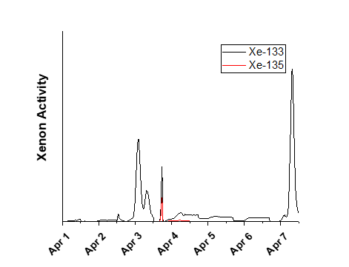
Update in Australia
A Mirion built system was installed in ANSTO in October 2018
System operating well
15 min data automatically transmitted to www.staxdata.net via encryption
Working to edit data sharing agreement to allow access by NDCs
High-purity germanium (HPGe) nuclear detector installed in ANSTO
Left: 133Xe Activity for April 2019. Right: 133Xe and 135Xe activity for April 1-7

Slide 6
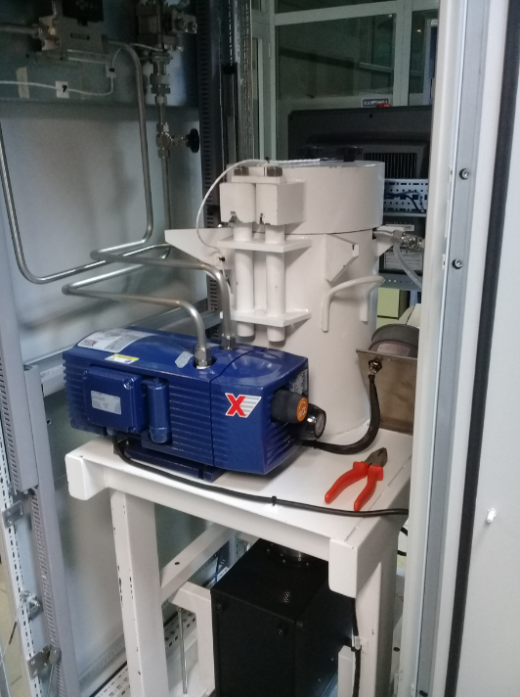
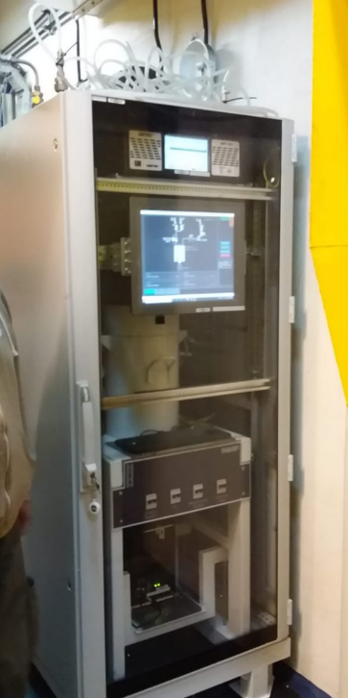
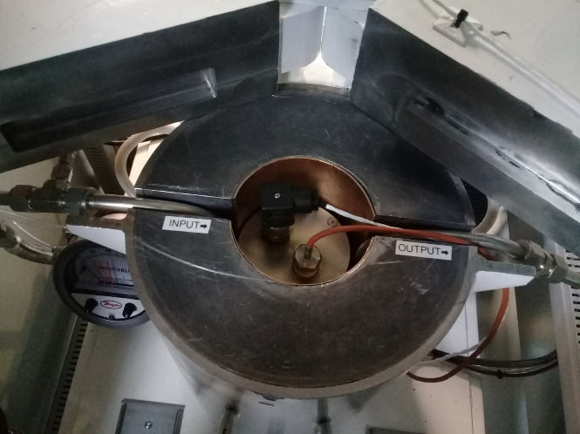
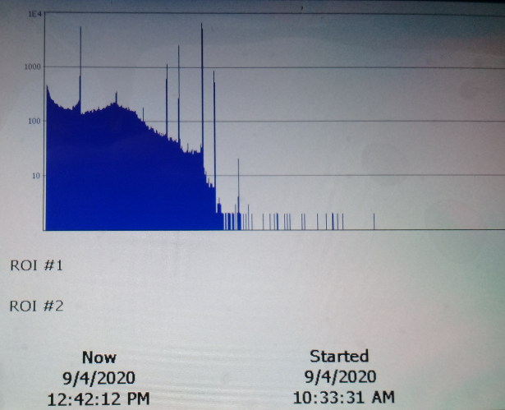
Update in Argentina
In September 2018, INVAP initiated the designing and building of the detector system
In August 2021, the system was installed in CNEA facility for testing
This year the details of a formal collaboration with CNEA are being developed
High-purity germanium (HPGe) detector installed in CNEA
Close-up view of the STAX HPGe system and examples of first data collected by the system

Slide 7
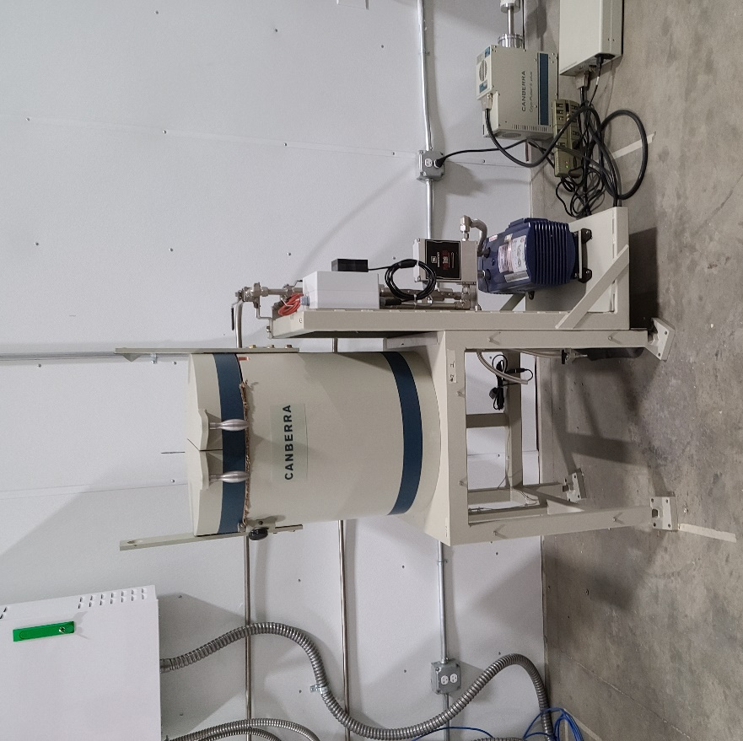
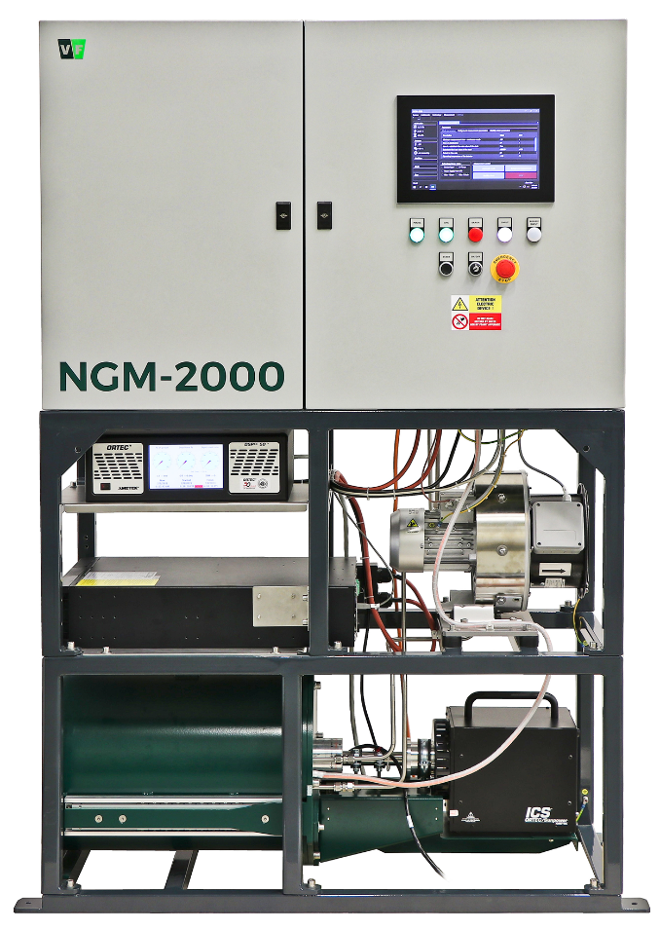
Update in the U.S.
Mirion built system installed at Niowave in March 2021
VF Nuclear built system installed in SHINE in June 2022
Data being automatically transmitted to database
Data sharing agreements will be established when activities ramp up at the facilities
Mirion High-purity germanium (HPGe) detector installed in Niowave
VF Nuclear High-purity germanium (HPGe) detector installed in SHINE

Slide 8
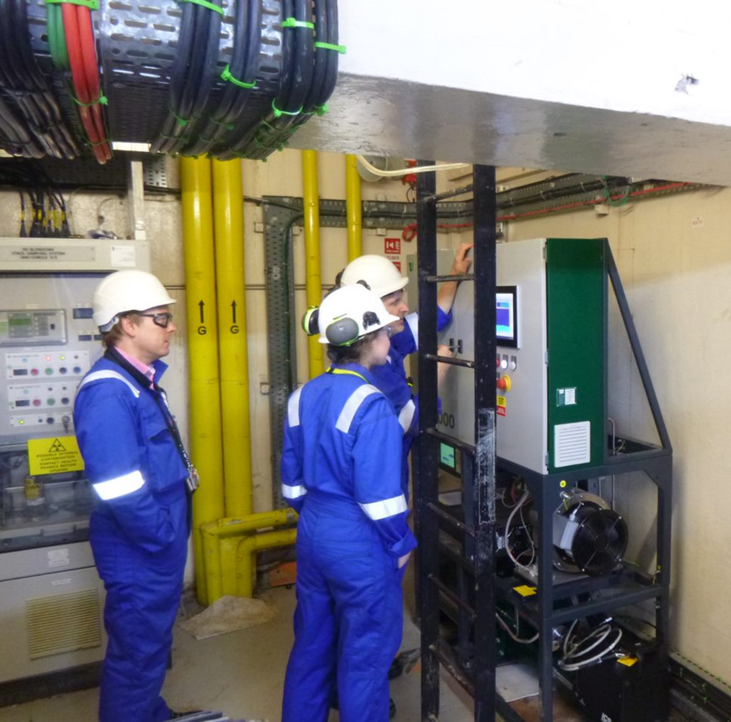
Data from Nuclear Power Plants
STAX system temporarily installed at Hartlepool NPP in the UK in September 2021 as part of XENAH
  Data is manually transmitted to www.staxdata.net via encryption
Forsmark NPP started sharing data with STAX in March 2021
Data comparison of MIP and NPP
  NPPs are not constant on a large time scale
  NPPs release much less than 1E9 Bq/day but can release more when doing something other than power production
VF Nuclear High-purity germanium (HPGe) detector installed at Hartlepool

Slide 9
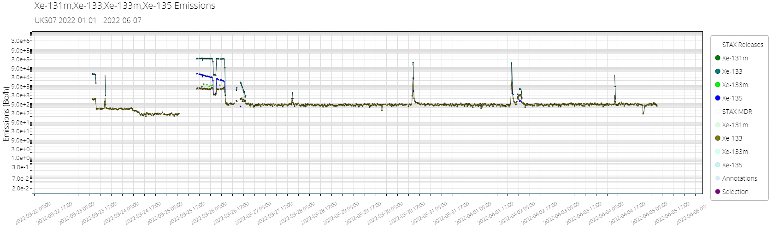
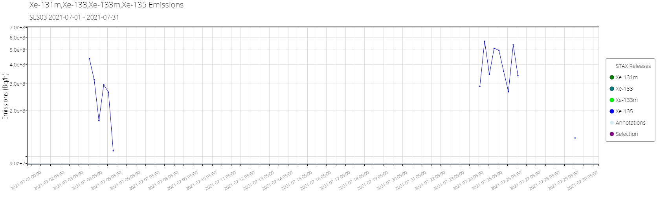
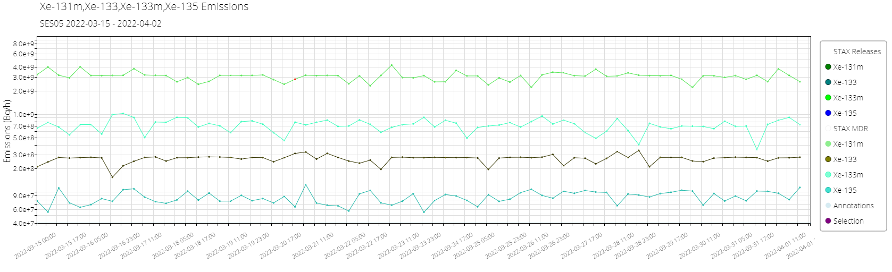
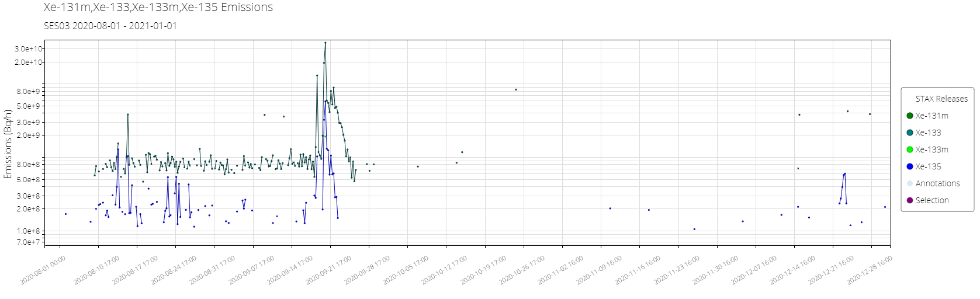
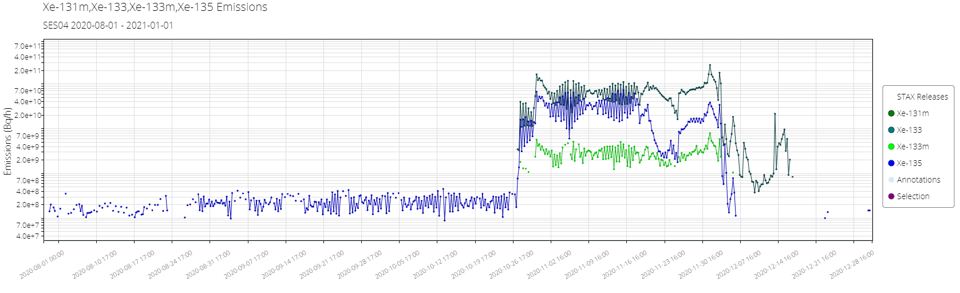
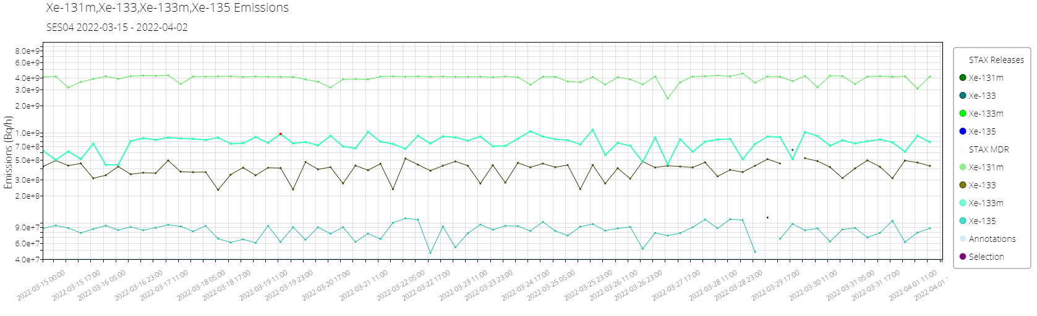
NPP releases
Hartlepool, UK
NPP releases not constant 1E9 Bq/d
  Nothing released (<2E8 Bq) under typical operations
Periodic (few times a year) releases will be roughly 10% of MIPF
Forsmark, Sweden
<2E8 Bq/h
3E11 Bq/h max

Slide 10
Contrast to MIP
MIPF range from 5E11 to 7E12 Bq/h peak releases daily
For ATM…
  For NPP, wind direction AND release amount matter
  For MIPF, only wind direction matters as release are enough to be detected every day.

Slide 11
Next Steps
Remaining STAX Phase 1 activities (ending September 2023)
  Additional installs
    System being purchased for CCHEN in Chile
    Ongoing discussions with additional facilities
  Continued data review and system maintenance
  Continued data sharing
  Development of tools to help streamline data use
Planning is underway for STAX Phase 2
  Focused on continued system maintenance and data sharing

