Slide 1
ROUNDTABLE
Participation in Stack Monitoring

Slide 2
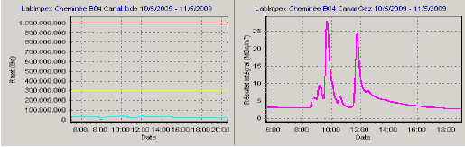
Comparison between IRE and STAX monitoring system
Working principle
IRE
STAX (Mirion)
Air flow
Air flow
« Marinelli » vessel
Charcoal
HPGe
HPGe

Slide 3
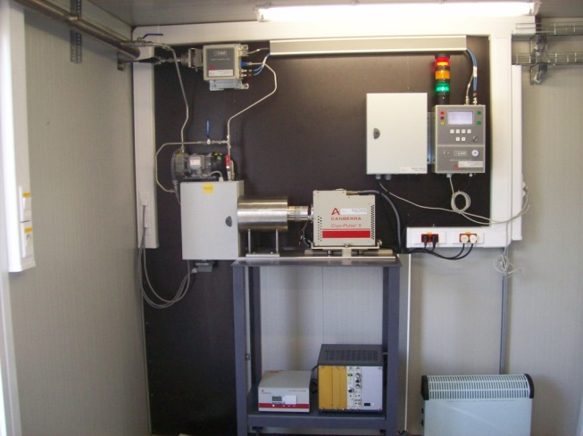
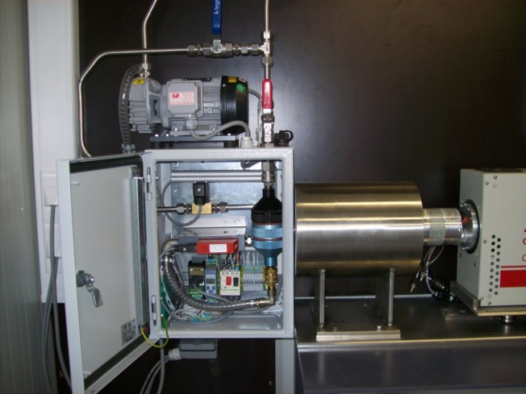
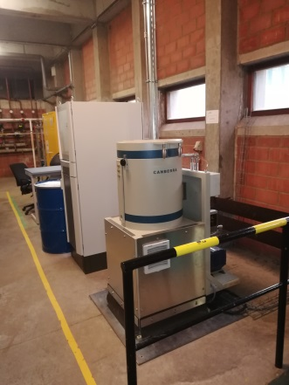
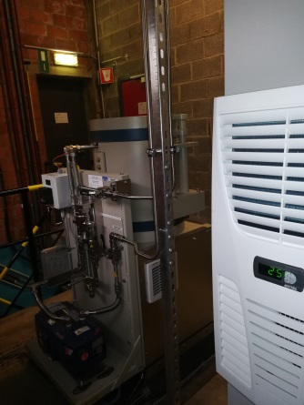
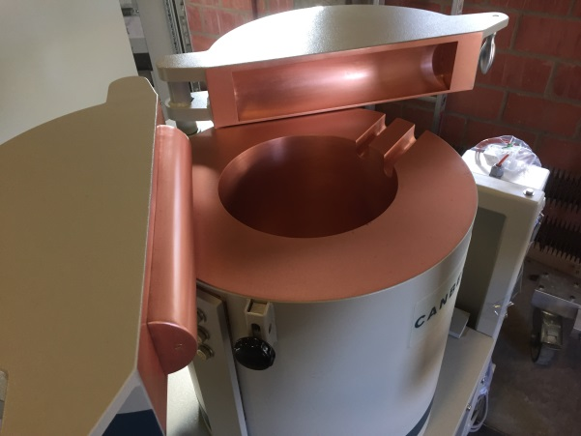
Comparison between IRE and STAX monitoring system
IRE
STAX (Mirion)

Slide 4
Comparison between IRE and STAX monitoring system

