Slide 2
XENAH: Xenon Environmental Nuclide Analysis at Hartlepool
Andrew Petts²,, Ashley Davies¹, Matthew Goodwin¹, Mark Arnold², Michael Warren², Anders Ringbom³, Theodore Bowyer⁴, Jonathan Burnett⁴, Judah Friese⁴, Jim Hayes⁴, Lori Metz⁴ ,Brian Milbrath⁴
¹Atomic Weapons Establishment, ²EDF Energy,
³Totalförsvarets forskningsinstitut (FOI), ⁴Pacific Northwest National Laboratory

Slide 3

XENAH - Overview
Scientists from the U.K., U.S., and Sweden are performing measurements involving a suite of radionuclide monitoring techniques in order to better understand radionuclide emissions from a nuclear power reactor and how those might affect the International Monitoring System. The Xenon Environmental Nuclide Analysis at Hartlepool (XENAH) collaboration will perform these measurements utilizing the Hartlepool Power Reactor in northeast England with cooperation of the reactor operator, EDF Energy
Reactor stack monitoring for radio xenon measurement at the source
Stand-off measurements of radioxenon after several km of atmospheric transport and dispersion
Radionuclide measurement of environmental and regulatory samples taken at or near the power station (including in-core coolant activity monitoring)

Slide 4
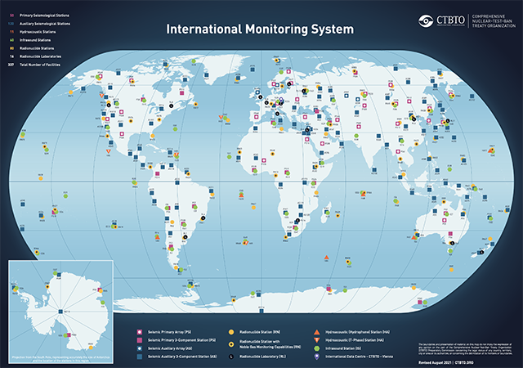

CTBT & IMS Overview
The Comprehensive Nuclear-Test-Ban Treaty (CTBT) is a multilateral treaty that would ban nuclear weapons test explosions and any other nuclear explosions, for both civilian and military purposes, in all environments. It was adopted by the United Nations General Assembly on 10 September 1996. 185 States have signed the treaty. 172 States have ratified, though the Treaty has not yet entered into force.
The International Monitoring System (IMS) is part of the verification regime for the CTBT and consists of four technologies to detect telltale indications of nuclear explosion: Seismology, Hydroacoustics, Infrasound and Radionuclides
When complete, the IMS will consist of 337 facilities including 80 radionuclide monitoring stations and 16 radionuclide laboratories
The IMS successfully detected all six of the DPRK nuclear tests

Slide 5
Hartlepool Power Station
Overview of an Advanced Gas-cooled Reactor and its operation

Slide 6

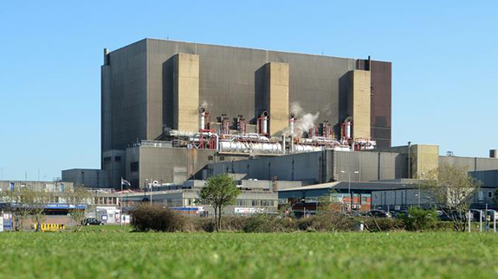
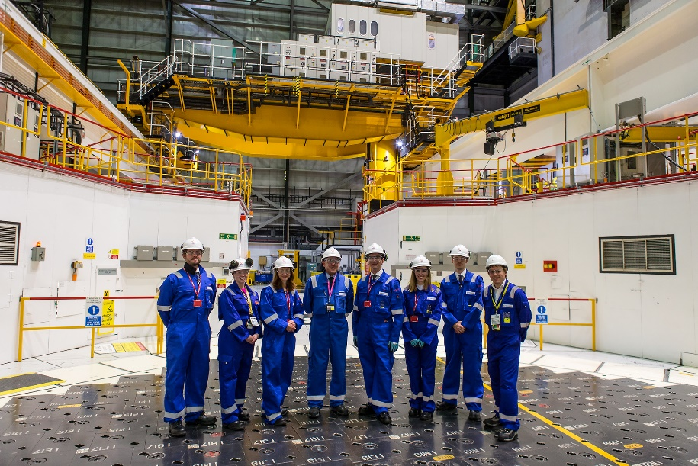
Hartlepool Power Station
2 Advanced Gas-cooled Reactors
Generates ~ 600 MW(e) each, enough to power 1.5 million homes
Employs ~500 full time staff members and ~200 full time contract partners
Has been supplying safe, clean, secure energy since 1983
Currently licenced until April 2024

Slide 7
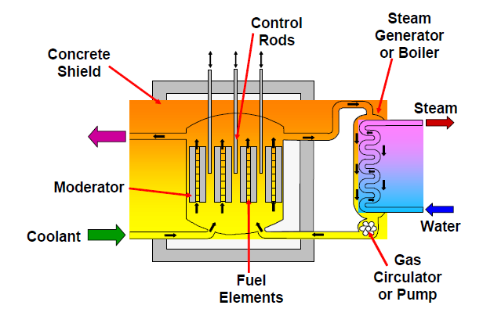

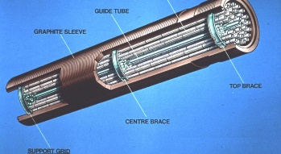
Advanced Gas-cooled Reactor Design
Reactor
Moderator | Graphite
Primary Coolant | CO₂ @ 41 bar, 3623 kg/s
Number of Fuel Channels | 324 with 460mm pitch
Number of Control Rods | 81
Active Core Dimensions | 9.3m x 8.2m
Mean Temps | T1: 286 °C, T2 648 °C
Fuel design
Material | UO₂, 3.2 – 3.78% enriched, 130 tonnes per reactor
Disposition | 36 pin cluster, graphite sleeve. 8 elements per fuel channel
Cladding | Stainless steel, 0.37mm thick
Average discharge irradiation | 30 GWd/tU

Slide 8
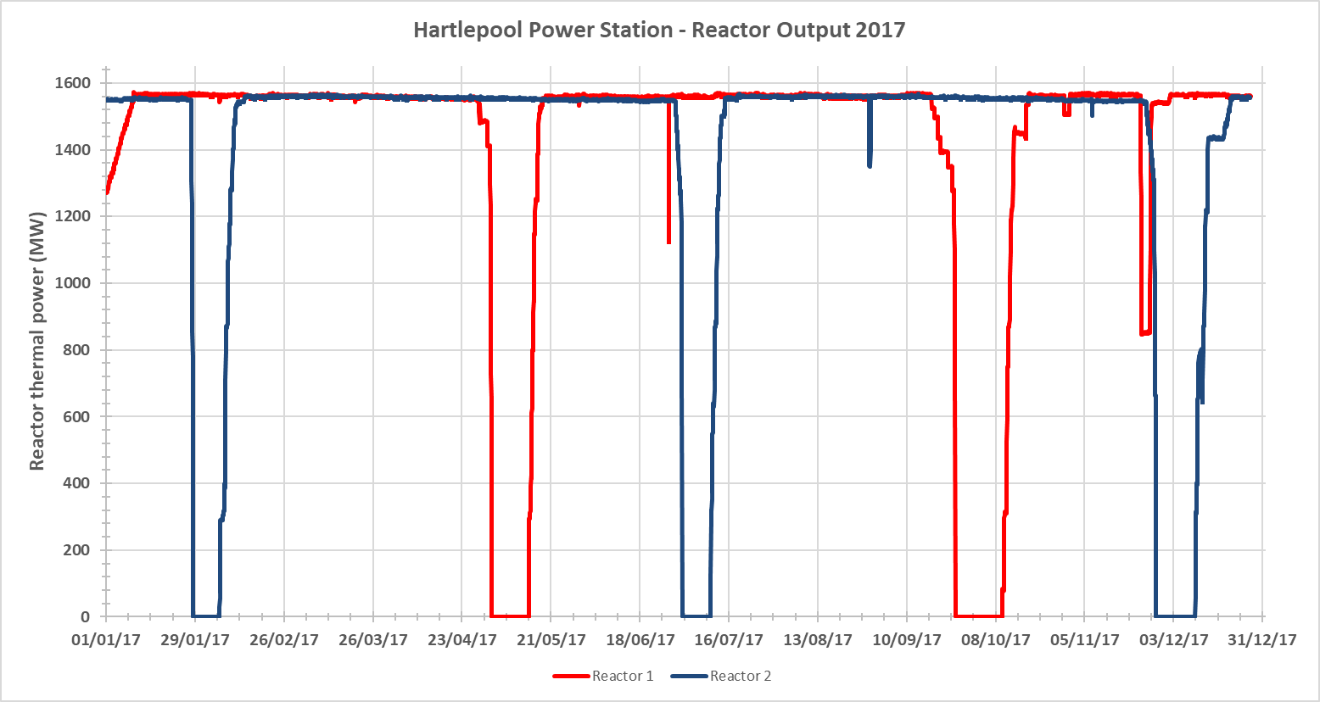
Hartlepool power station operation
Reactors nominally produce ~1560 MW thermal power each
Usually 5 refuelling outages per year across the two reactors, lasting 10 - 14 days each
Off-load, depressurised, batch refuelling
~20 channels refuelled during each outage
During depressurisation, estimated 11.7 GBq of ¹³³Xe released over a 24 hour period

Slide 9
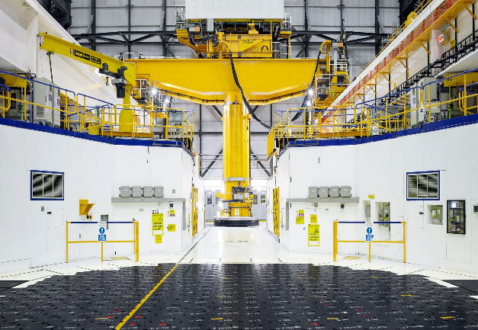

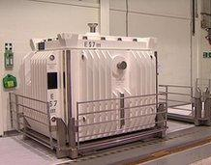

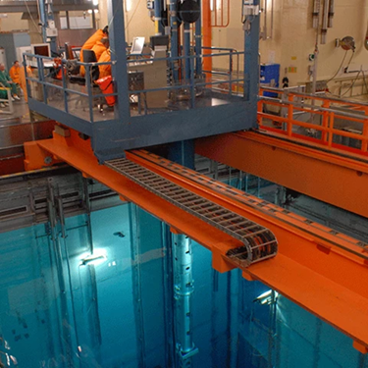
Journey of the nuclear fuel
Fuel spends ~ 8 years in the reactor
Once out of the reactor, fuel must be below 16 kW before it can be dismantled at the IFDF – this typically takes around 2 weeks, during which the fuel is housed in special ‘buffer stores’
Once below 16 kW, fuel is dismantled at the IFDF and sent to the cooling ponds
Fuel must cool to < 12 kW decay heat and spend at least 90 days within the ponds
Fuel elements are placed in a ‘flask’ for transport
Flask with irradiated fuel is transported by train to Sellafield for reprocessing and long-term storage
Wherever nuclear fuel is handled, active Heating and Ventilation (H&V) is discharged through a filtered route

Slide 10
XENAH Project Workstreams
What we aim to achieve and where we currently are

Slide 11
XENAH - Workstreams
Reactor stack monitoring for radio xenon measurement at the source (STAX)
Stand-off measurements of radio xenon after several km of atmospheric transport and dispersion
Radionuclide measurement of environmental and regulatory samples taken at or near the power station (including in-core coolant activity monitoring)

Slide 12
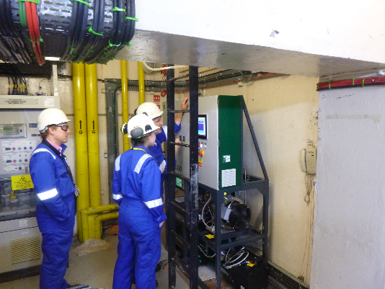
Reactor stack monitoring for Xenon emissions
NGM-2000 System by VF Nuclear
30% HPGe detector
MDC 270 Bq/m³ for ¹³³Xe
Flow through system: 1.25 m³/hr
Continuous monitoring (15 minute acquisitions, looped)
Typical of STAX systems employed at Medical Isotope Production facilities
System’s primary aim is to measure radioxenon isotopes, but is sensitive to all gamma-emitting gaseous fission products
Air extracted from stack flows through Marinelli beaker. Measured concentration is adjusted by total stack flow.
Stack flow peaks around 1400 m³/hr during blowdowns
System installed at R6 tower (main blowdown route)
Some issues with data transfer (sneakernet) which have (hopefully) now been resolved
Has measured most recent blowdown

Slide 13
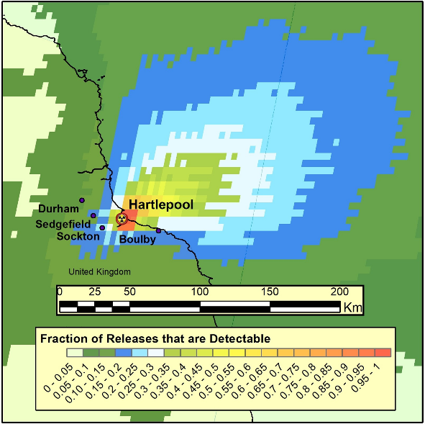
Stand-off measurements – 3 SAUNA detector array
Scienta SAUNA Qb specs
Intakes atmospheric sample and produces ~1.3 cm³ of xenon per period
Sample time of 12 hours (includes gas conditioning)
Qb consists of single b-g detector consisting of 18ml plastic scintillator detector inside a 4 inch NaI crystal
¹³³Xe MDC ~ 0.4 mBq/m³
Locations and goals
3 detectors (1 each from U.K., U.S. and Sweden) at different locations a few 10’s of km around Hartlepool: Boulby, Durham, Leeds
Comparisons of the stand-off measurements with predictions based on atmospheric transport of stack monitor results are a key measurement goal of the project
Evaluate advantages of an array network over single station and how this could improve the IMS
System running at all 3 locations during March Blowdown
Hysplit simulations using one year of metrological data archived on a 25 km, 3 hr basis

Slide 14
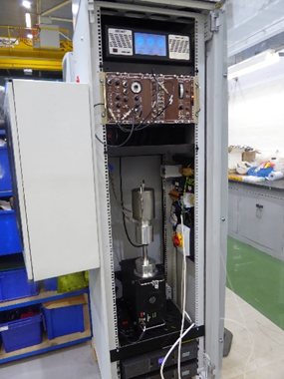
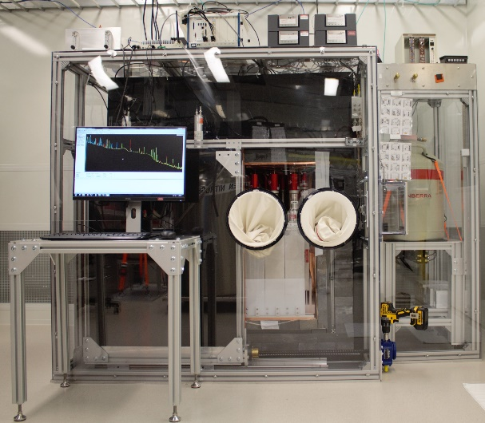
In-Core and Environmental sample analysis
In-Core measurements
Gaseous Activity Monitoring (GAM) measures in-core coolant activity to assess fuel condition
40% HPGe detector feeding MCA for isotopic analysis and NIM modules for analogue Central Control Room (CCR) indications and alarms
1 hour acquisition, continuous flow of 1 litre/s
Used to monitor for fuel performance – particularly during blowdowns
March Blowdown monitored
Environmental measurements
Maypack charcoal and paper filters provided from various locations at Hartlepool (pond stack, R6 blowdown Stack, GCMF etc)
Samples measured at Boulby underground laboratory and the Shallow Underground Laboratory at PNNL
Laboratories able to perform ultra-sensitive g-ray spectroscopy. Usually used to measure treaty-relevant radionuclides
ARGO at PNNL combines low background, cosmic veto, Compton suppression and coincidence functionality
Aim is to provide radionuclide fingerprint of an operating AGR

Slide 15
XENAH Preliminary results
Measurements of recent emissions from Hartlepool

Slide 16
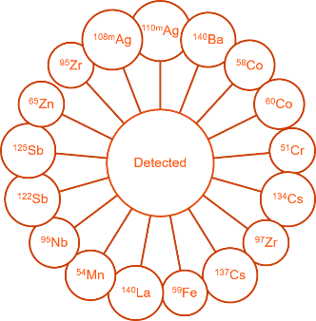
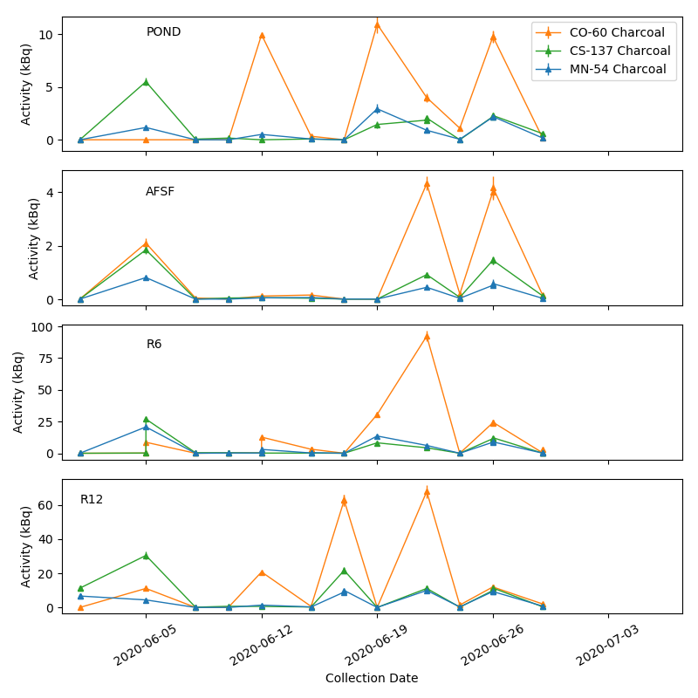
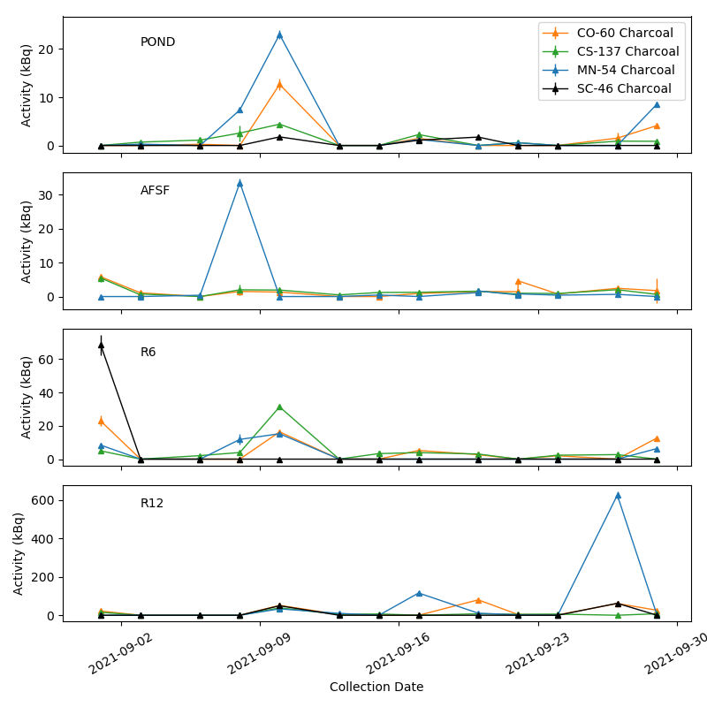
Ultra-sensitive sample analysis
Prior to measurement at PNNL and AWE, each sample is measured using conventional gamma-spectrometry systems at EDF Energy for environmental compliance
The ultra-sensitive measurements have identified trace levels of fission and activation products, including ^{108m}Ag, ^{110m}Ag, ⁵¹Cr, ⁵⁴Mn, ⁵⁸Co, ⁶⁰Co, ⁹⁷Zr and ¹³⁷Cs., many of these are sometimes seen in IMS data
Analysis focused on longer-lived radionuclides (e.g. ⁵⁴Mn, ⁵⁸Co, ⁶⁰Co, ¹³⁷Cs) at fuel handling locations
Measurements reveal increases in radionuclide activities during fuel handling
Information from activation-product discharges could possibly infer if a facility is handling nuclear material

Slide 17
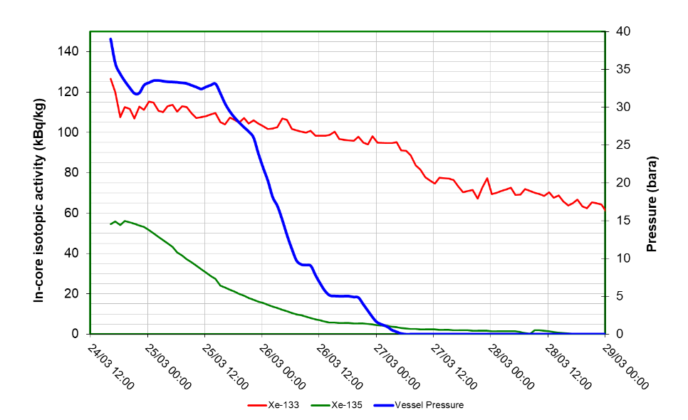
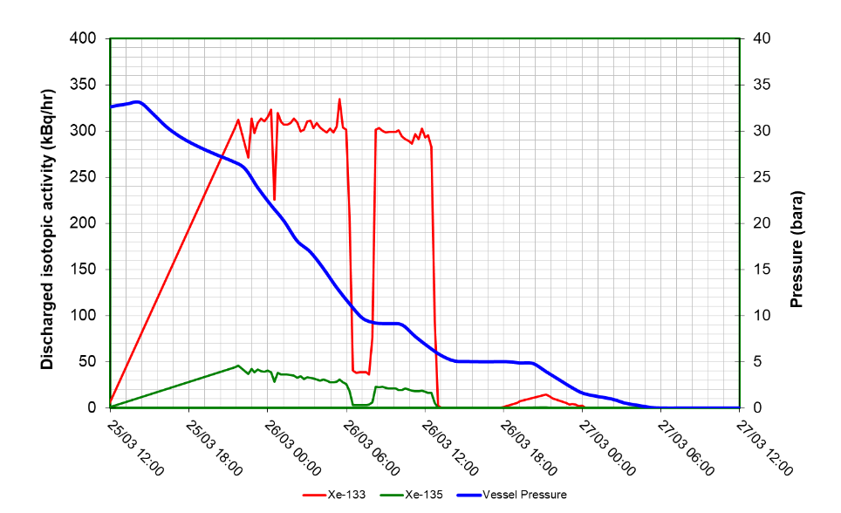
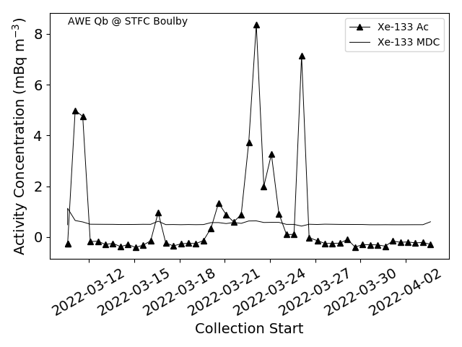
Radio-xenon measurements of March blowdown
GAM system measured ¹³³Xe and ¹³⁵Xe activity during depressurisation with a typical profile observed
Stack monitor detected xenon isotopes going up through the stack. Some data drop outs during blowdown
Boulby Qb also detected an above-background ¹³³Xe signature during period of blowdown

Slide 18
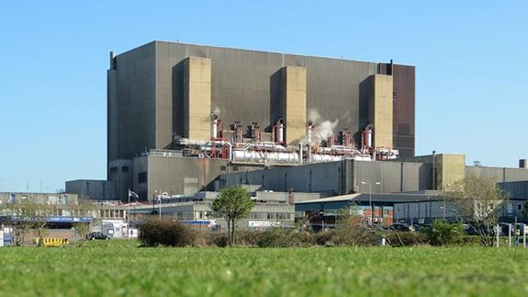
Next Steps…
Measure next major emission in June looking at correlations in core data, stack data and Qb data
Analyse current data sets from March blowdown looking particularly at xenon ratios, comparing with Kalinowski plot
Submit paper to PAGEOPH covering Environmental sample analysis
Analyse 5 years worth of in-core coolant activity specifically xenon ratios
Obtain/produce AGR ‘fingerprint’ from emissions data
Compare Qb array performance and detections to ATM predictions
Produce over-arching paper covering in-core -> Stack - > atmosphere emissions from an operating nuclear facility
Hartlepool is also collaborating with the AIT-WATCHMAN project to assess anti-neutrino emissions from a nuclear facility for non-proliferation purposes.
Calculation of the radioxenon isotope ratios shows values right of the nuclear explosion discrimination line during AGR start-up and left during routine AGR operation.

