Slide 1
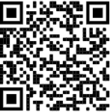
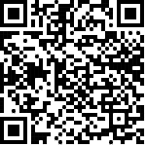
Download the WOSMIP App
You should have received an invitation senT to the email you registered with. Please check your Junk folder or “other” folder. The email will come from support@crowdcompassmail.com
APPLE
ANDROID

Slide 2
Announcements:
Dinner tonight is sponsored by FOI and CTBTO
Please wear comfortable walking shoes and a jacket
Boat tickets will be required for entry – If you do not plan to attend the dinner, please turn in your ticket to the registration desk
Additional drinks will be available by credit/debit card only
Ship leaves promptly at 6pm. Please arrive by 5:45pm
If you are interested in additional tickets, please see the reception desk
Please scan the QR Code for directions to the loading dock:

